Slide 1
Lavelle Networks
Notes:
We come from a strong enterprise datacenter technology background and have seen customers struggle with massive transformations over the last 3-5yrs.These transformations are driven by business changes in offering SaaS business models, data driven business operations (IoT) and enabling mobility of end users. These have warranted large enterprises to rapidly push services to their consumers in a “devops” style operations giving very little leeway for inefficiencies / delays in time2market.
While large enterprises are adapting to this change by offering virtual versions of the same legacy products, we have seen enterprises struggling with complex service chains in bringing multiple virtual appliances work together.
The enterprises have already adopted virtualization in a big way when it comes to storage and compute in their data centers in order to be nimble and agile to respond to their rapidly changing business environment. The networking side of the story has been a laggard till date with little movement forward with virtualization of the data and control plane with products such as VMWare NSX and Juniper OpenContrail. The network services has been slowest leg of the whole journey towards agility and simplicity with the approach of virtualizing what was a hardware box till date with network functions virtualization effort led by IETF. This still doesn’t solve the problem as you are creating a virtual form factor of a legacy hardware appliance.
On the other hand, we have intimately observed open architectures evolve with (Intel) platform support for user-mode manipulation of the data plane and mature orchestration capabilities develop in OpenStack. We strongly believe enterprises need a fundamental redesign of application of network functions on the data plane to reap high performance & efficiencies needed to stay competitive in the service driven economy.
With the enhancements in the semiconductor technology and newer architectures from Intel (with platforms supporting user driven manipulation of the data plane), it is now possible to build virtualized network functions like Security, Load Balancers, Encryption (IPSec) and apply those functions right at the data plane itself. These L7 network services enable operators to monetize their infrastructure with rapid / simplified application development.

Slide 2
Mission
Rapid service deployment in datacenters by
converged ToR switching & L3-L7 network functions
ToR switching = Top of Rack Switching
L3-L7 Network Functions = Load Balancing, Security, Application Delivery Controller (ADC), Routing

Slide 3
Current Problems
Legacy network infrastructure high on Capex, slow on service performance & hard to manage
New bare metal/SDN switching solutions silo’ed, do not integrate with L4-L7 application services
Load balancing, Security, Routing deployed in isolation
Challenges impacting time to market for web-scale, Telco/IaaS & Enterprise customers
Reduce service time2market to below 12mo (current best 18mo)
Notes:
Quantify the cost of not integrating L4-L7 with ToR
14Mpps DPDK line rate vs F5 VM line rate
eBay 18mo to deploy services on datacenters from concept

Slide 4
Bare-metal/SDN/NFV Challenges
No contextual steering of traffic from switches to service VMs
No performance management for compute intensive applications like SSL
Limited orchestration capabilities for routing, ADC & security VMs with bare metal switching
Complexity in setup, configuration & troubleshooting

Slide 5
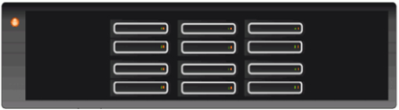

Technology Evolution with Lavelle
Traffic from other racks
Traffic from other racks
FW
Each rack has it’s own services ; capacity is aggregated across racks.
IPSec
IPSec
FW
LB
LB
IPSec
LB
FW
Now : Network functions as hardware appliances
NFV : Network functions as VMs
Lavelle : Network functions as distributed services at the ToR
Each vendor has it’s own management solution
Unified management

Slide 6
Lavelle Technology
ToR switch OS service delivery platform:
Contextual steering of traffic to L4-L7 service VMs
Real-time offload of compute intensive services to servers in the rack
OpenStack based service chaining of network functions across 3rd party & native applications
No custom hardware
Transparent insertion of existing virtual network functions

Slide 7
Technology Inflections Leveraged
Dense cores/ports in commodity servers making bare-metal HW 1/3 of traditional switches
40GbE making poll-mode user space network drivers (Intel DPDK) viable over older interrupt-mode kernel drivers (Intel DDIO), opening a new control point to steer traffic
Mature compute orchestration now available with OpenStack

Slide 8
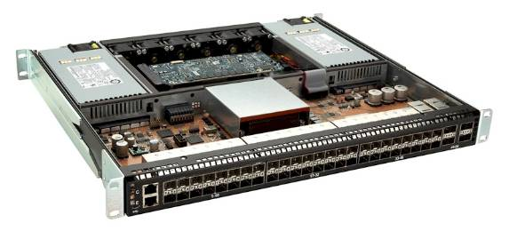
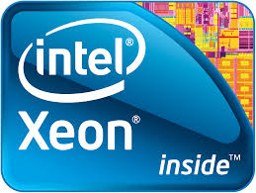
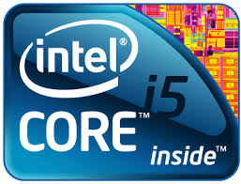
Product Platform: SmartToR
User-space
L4-L7 Services
Load Balancer
Firewall
IDS/IPS
…
Storage Proxy
3rd Party VM
…
3rd Party VM
L2-L4 Contextual
Orchestration
Linux
Cluster Client
Service Chaining Hub
Orchestration Plugin
Service SDK
Commodity
ToR Hardware

Slide 9
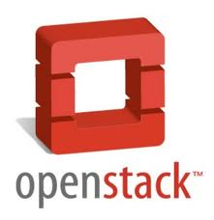
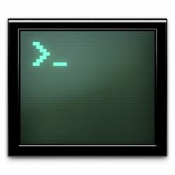
Demonstration Topology
10.10.11.150:8090
| 10.10.11.150:8091
Web Svc
(NginX)
Web Svc
(NginX)
10.10.11.2
L4-L7 Service
Orchestration
LB
(HAProxy)
IDS/IPS
(Snort)
Service
Deployment
SmartToR Service Hub
CLI
L2-L4 Traffic
Steering
ovs – ofctl
SDN Switch
(OVS)
Commodity
Hardware
Video: https://www.youtube.com/watch?v=gzDnDZ4ENEg

Slide 10
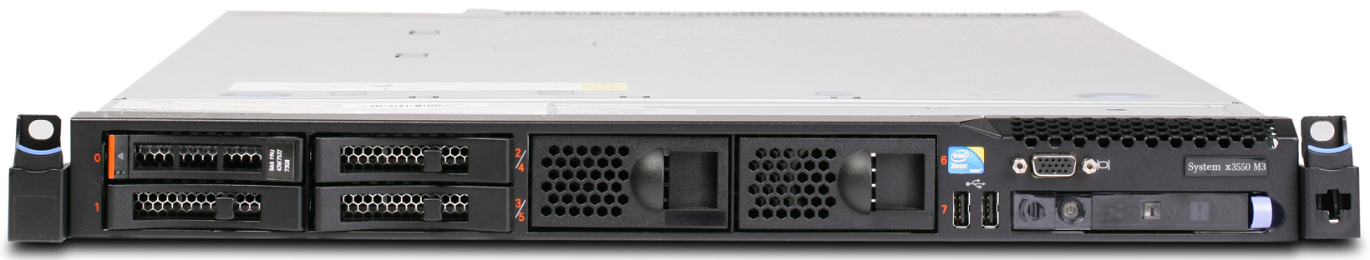
OpenStack based Orchestration
FW
LB
IDS/IPS
IPsec
FW
LB
IDS/IPS
IPsec
Svc Hub
OpenStack ML2 Agents
Svc Hub
OpenStack ML2 Agents
ToR Switch Server
ToR Switch Server
Eth Port
VM
Eth Port
VM
Rack server
Rack server
Service Hub orchestration on SmartToR engages with OpenStack Neutron service chaining to service the steered traffic flows
Host network orchestration uses Open vSwitch to offload service VMs to rack servers or other ToR switch server

Slide 11
Addressable Market Size
Market analysis based on JP Morgan 2014 Networking Outlook
Addressable market includes only infra impacted by bare-metal deployment
SmartToR’s addressable segments limited to ToR switching, Security, ADC & Routing, other user-defined/3rd party apps excluded in this model
Bare metal impact projected at 10% in 2014, growing to 30% by 2017
Continued growth in switch ports & deterioration of port ASP assumed
Segment | CY14 ($M) | CY17 ($M) | CAGR | New CY15
ToR HW | $407 | $1,463 | 53% | $216.44
ToR SW | $194 | $698 | 53% | $103.34
Security | $435 | $1,625 | 55% | $239.92
ADC | $128 | $477 | 55% | $70.48
Routing | $65 | $235 | 53% | $34.77
Total | $1,229 | $4,498 | 54% | $664.95

Slide 12
Competition
Switch OS / Platform | L4-L7 Applications | Converged Platform
Cumulus Pica8 Pluribus Quagga Big Switch BIRD Zebra XORP | F5 Palo Alto Networks A10 Embrane Pertino Vyatta (Brocade) Vello | VMware NSX Juniper OpenContrail

Slide 13
Product Development Plan
Phase | Timeline | Engineering Milestone | Customer Milestone
Sprint-1 | Q1-Q2 | Switching OS L3/L4 FW L4 LB NAT | Professional services engagement, 1-2 web-scale customer(s) with bare-metal switch deployment
Sprint-2 | Q3-Q4 | L7 LB (Scripting) IPSec (Encryption/SSL) | Kick-start pilot project, Showcase one L7 service on ToR
Sprint-3 | Q5 | 3rd Party VM (Chaining) Orchestration | Completion of customer pilot, Identify service chains of strategic customer interest
Beta Release | Q6-Q8 | Performance engineering Switching OS Optimization QA | Kick-start production engagement with customer, Begin subscription revenues from customer

Slide 14
Development Resource Planning
Development Function | Headcount [Q1-Q4] | Headcount [Q5-Q6]
Switching | 2 | 2
L3/L4 Services | 2 | 2
L7 LB | 4 | 4
IPsec Encryption | 4 | 4
3rd Party VM (Chaining) | 2 | 4
Orchestration | 4 | 8
System testing | 1 | 6
Total | 19 | 30

Slide 15
Operating Plan
 | Q1 | Q2 | Q3 | Q4 | Q5 | Q6 | Q7 | Q8
Milestone | Design | Switch OS L3-L4 Svcs | L4-L7 Develop. | L7 LB IPsec | 3rd Party VM | Perf testing | Beta release | Customer Engagement
Cash burn | $750k | $900k | $1,650k | $1,700k | $1,900k | $2,100k | $2,500k | $3,500k
Cumm. Cash Burn | $750k | $1,650k | $3,300k | $5,000k | $6,900k | $9,000k | $11,500k | $15,000k
HC | 11 | 15 | 18 | 22 | 26 | 29 | 34 | 41
Engineering | 10 | 14 | 17 | 19 | 22 | 25 | 27 | 30
IT | 0 | 0 | 0 | 0 | 1 | 1 | 2 | 2
Sales | 0 | 0 | 0 | 1 | 1 | 1 | 2 | 5
Mktg/Alliance | 1 | 1 | 2 | 2 | 2 | 2 | 3 | 4
PoC Equipment | $500k | $500k | $500k | $500k | $500k | $500k | $500k | $500k
Notes:
Cost/HC = $100k/year (assumes India operations)
PoC equipment involves 1 PoC rack/qtr including ToR server, rack servers & rack opex at a colo

Slide 16
GTM
Web-scale [E.g.: Groupon, Google] | Leverage rapid penetration of SDN/Bare-metal switching Insertion strategy based on a bolt-on with existing bare-metal switch OS [like Cumulus] Upsell performance with Lavelle Switching OS
SPs/IaaS [E.g.: Verizon, AT&T] | Leverage compute cross-sell with ToR for service VMs Insertion strategy based on a partnership with server vendor [like Dell] & server VAR for X-selling compute Ship high performance Lavelle Switch OS with network service stack
Enterprises [E.g.: JP Morgan, Thomson Reuters] | Leverage increased spend on security Insertion strategy based on fast deployment of IPSec / encryption (SSL) solution with elastic compute orchestration Leverage server vendor partnerships from SP GTM

Slide 17
Revenue Projection
Year | Targeted Segment | Revenue Projection | Estd. Customer TCO Benefit
2015 | Web-scale Projected 1% share of new deployments No competition take-out | $7M | $17M
2016 | Web-scale, SPs/Telco Projected 2% share of new deployments Bare-metal OS competition | $15M | $37M
2017 | Web-scale, SPs/Telco, Enterprises Projected 10% share of new deployments Bare-metal OS, NSX competition | $70M | $170M
Note:
Conservative estimation of customer TCO benefit includes benefits from software ToR switching (45%), virtualizing L7 network services (15%) and estd. efficiencies in convergence of ToR switching with L4-L7 services (40%)

Slide 18
Lavelle Team
Team bring unique combination of skills relevant to the problem : Software Defined Networking, Intel DPDK platform, Distributed Systems design, High-performance networking, and Virtualization
Worked in companies like Juniper, Microsoft, ARM, NetApp and have previous startup experience
in networking, storage & orchestration
Experience across development, engineering management, strategy & business development
Actively engaged with key developers and related open source projects

Slide 19
Why should Lavelle win?
 | We can, They can’t | They can, we can’t
Existing TOR Vendors (Cisco, Arista, Juniper) | Cannibalize existing ASIC based Hardware solutions Direct top Line hit for the incumbents if they take this approach | Drop prices and negate the impact of COTS based TOR solution Sweeten TOR deals with freebies for services
L4-L7 Network Services Vendors (e.g. Palo Alto Networks, F5) | ToR not the primary business, will be entering a new market Hardware Appliance Top line with take a direct hit | Increase market share in specific NFV services segment given that they are incumbents Invest in research required for specific services like security
NFV Vendors (Startups in NFV space) | NFV Vendors focus is limited to virtualizing network functions | Nothing stops NFV vendors to take this approach

Slide 20
Thank you

